Slide 1
Prediction of Recovery Factor using Machine Learning Methods Dr. Munish Kumar and Kannappan Swaminathan
Match 2022

Slide 2
Disclaimer
ERC Equipoise Ltd (“ERCE”) has made every effort to ensure that the interpretations, conclusions and recommendations set out in this presentation are accurate and reliable in accordance with good industry practice. ERCE does not, however, guarantee the correctness of any such interpretations and shall not be liable or responsible for any loss, costs, damages or expenses incurred or sustained by anyone resulting from any interpretation or recommendation made by any of its officers, agents or employees.
This presentation is produced solely for the benefit of and on the instructions of ERCE’s client to whom it is presented, and not for the benefit of any third party. Any third party to whom the client discloses or makes available this presentation shall not be entitled to rely on it or any part of it.
All estimates of reserves and resources in this presentation are provisional and subject to change. The client agrees to ensure that any publication or use of this presentation which makes reference to ERCE shall be published or quoted in its entirety and the client shall not publish or use extracts of this presentation or any edited or amended version of this presentation, without the prior written consent of ERCE.
In the case that any part of this presentation is delivered in digital format, ERCE does not accept any responsibility for edits carried out by the client or any third party or otherwise after such material has been sent by ERCE to the client.
ERCE has used standard petroleum evaluation techniques in the preparation of this report. These techniques combine geophysical and geological knowledge with assessments of porosity and permeability distributions, fluid characteristics and reservoir pressure. There is uncertainty in the measurement and interpretation of basic data. ERCE has estimated the degree of this uncertainty and determined the range of petroleum initially in place and recoverable hydrocarbons. Our methodology adheres to the guidelines of the SPE PRMS, unless specifically instructed to do otherwise. The accuracy of estimates of volumes of oil and gas and production forecasts is a function of the quality and quantity of available data and of engineering interpretation and judgment. While estimates of Reserves and production forecasts, Contingent Resources and Prospective Resources presented herein are considered reasonable, these estimates should be accepted with the understanding that reservoir performance subsequent to the date of the estimate may justify revision, either upward or downward. In the estimation of future cash flows, ERCE has relied upon oil prices and contract terms assumed and provided by the client, which may not reflect future signed contract values. There is no guarantee that actual economic parameters will match the assumed values. The net present value (NPV) calculations presented in this report simply represent discounted future cash flow values. Though NPVs form an integral part of the fair market value estimations, without consideration for other economic criteria they are not to be construed as ERCE’s opinion of fair market value.

Slide 3
Motivation
Recovery Factor (RF) is one the most critical, and sometimes subjective, inputs towards determine field reserve → no clear approach to calculate or estimate given the variety of factors governing its value
Culmination of technical as well as non-technical aspects (analogs, experience based) and can consider both quantitative and qualitative parameters in its evaluation
Estimating Reserves
Analogs
Early Field Life
Volumetric
Early to Mid Field Life
Material Balance
Decline Curve Analysis
Mid to Late Field Life
Numerical Reservoir Simulation
Mid to Late Field Life
Mid to Late Field Life

Slide 4
How Operators Predict Recovery Factor

Slide 5

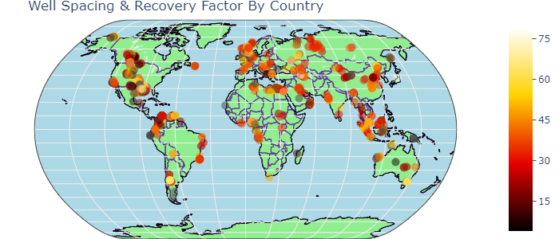


Objectives
Can we predict RF?
Develop a method, similar to operators, but using machine learning (ML) and artificial intelligence (AI) methods
Investigate and understand variables that have an impact on Recovery Factor using ML and AI methods
Determine what parameters are important in RF prediction
Reduce the subjectivity of RF determination by proper parametrization of the problem
Determine and rank the effectiveness of different ML algorithms
Develop a technique where ERCE can “market” AI based solutions to client, or reduce the instances of client disagreement
Understand some of the ML and AI solutions being developed in literature and industry
Completely unstructured Dataset – open-source, global, both carbonate and sandstone reservoirs, all fluid types, including recovery mechanism. In total, data set has 342 columns and 1447 rows in total.
Categorical columns | Numerical columns | Total Data Set Size | Total Number of Usable Data Points
226 | 115 | 494,874 | 194,241

Slide 6












Machine Learning Approach
Data Collection
Data Preparation
Choose Learning Algorithm
Train the Model
Test the Model
Deployment/ Evaluation on a “Blind” Data Set

Slide 7
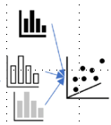

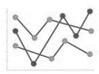





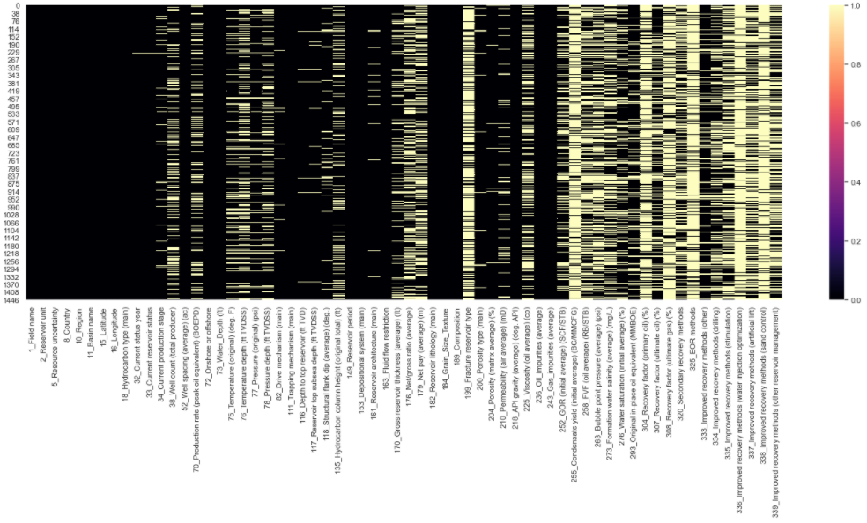
Data Collection & Data Preparation
Exploratory Data Analysis
&
Statistics, grouping of variables, determining nature of variables
Load Data
Attributes?
Uni/ Bi/ Multivariant/ Statistics?
Missing Values, Abberants, Outliers
Engineer the features
Drop Data based on criteria
Relabel
Data Cleaning
X | Y
a | b |  | Z
a | b |  | c
a | b |  | NAN
a | b |  | NAN
a | b |  | NAN
 |  |  | NAN
Most time-consuming process; involved removing duplicates, fixing indexes, replacing incorrect characters, normalization of names etc
Fill Missing with regression-based values
Typically, data scientist use statistics to look for statistical patterns, fill values based on these “patterns”
A better alternative is to apply DOMAIN KNOWLEDGE where a RE/ Petrophysics uses industry learnt relationships and applies them as regressional trends to create pseudo-data
The alternative to handle missing values is to DROP the missing variables. When this was done, we ended up with only 712 numerical data points or 0.37% of the original data set. .

Slide 8
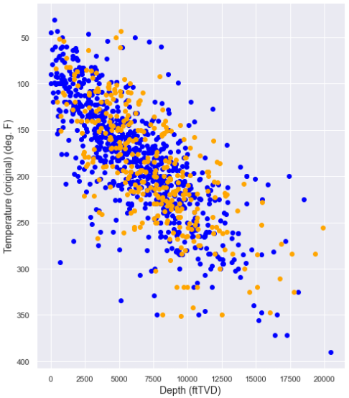
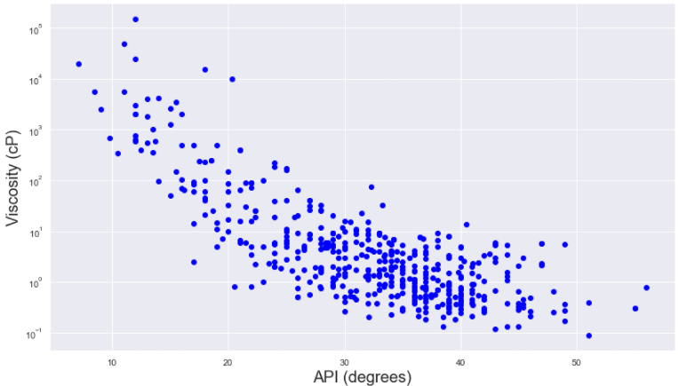

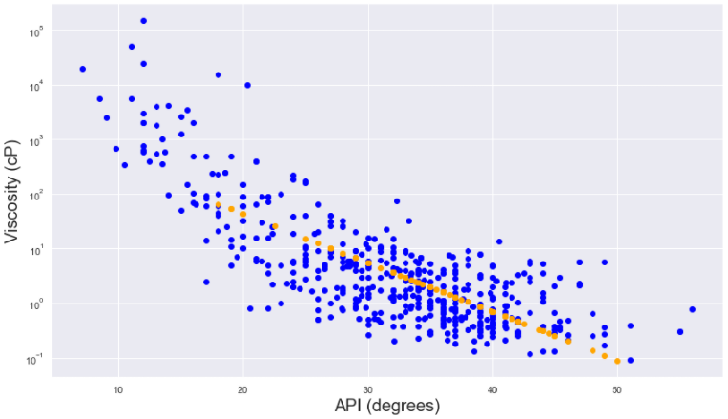
Domain Knowledge to fill Missing Values
Temperature-Depth Correlation
API-Viscosity Correlation (Sandstone, Oil)
Carbonate
Pre-fit
Sandstone
Post fit
~11% of the temperature values are missing. This can be corrected for using a “generalised” regression trend.
~20% of the viscosity values are missing. This can be corrected for with a correlation trend line between viscosity and API

Slide 9
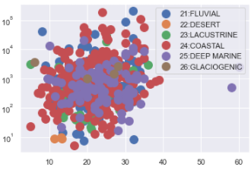
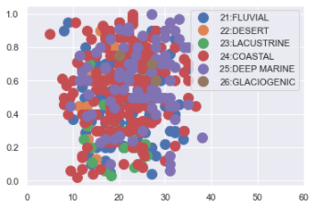
Domain Knowledge (Con’t)
Utilization of Regressions and relationships to fill Missing values
Temperature-Depth (Linear - Linear)
Pressure-Depth (Linear - Linear)
Porosity-Permeability (Linear - Log)
API-Viscosity (Linear-Log)
GOR-Pressure (Linear-Linear)
STOIIP-Porosity (Linear-Linear)
Reservoir Architecture (Categorical, Fill Missing with Mode)
Structural Dip (Numerical, Fill Missing with Average*)
Dummy Variables – Point Creation & Cumulative Scoring
Correlation ≠ Causality
Domain knowledge informs us that NTG & Porosity are independent variables required to evaluate STOIIP. Therefore, while the 2 plots look similar, correlation for one is possible, but makes no sense for the other (geologically).
STOIIP (MMstb)
NTG
Missing values in NTG cannot be corrected with porosity
Porosity (%)
Porosity (%)
* This column was later dropped as it made no difference to the model

Slide 10
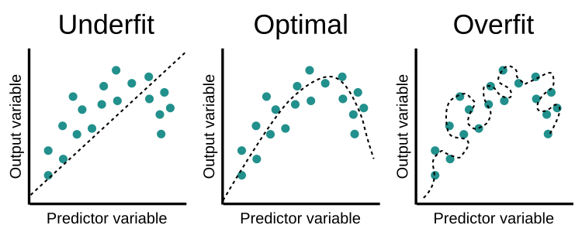
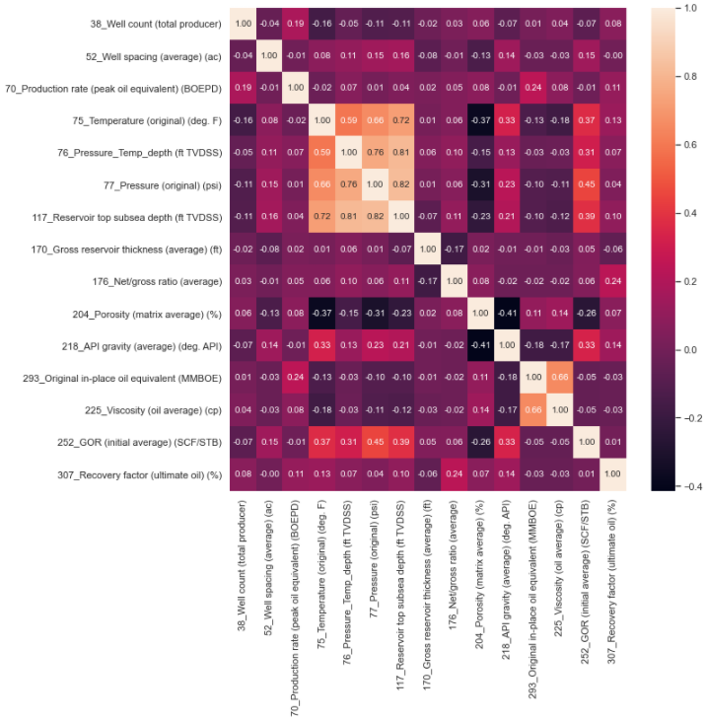
(Multi)collinearity
(Multi)collinearity is a condition where a predictor variable correlates with another predictor variable strongly. Therefore, changes in one of variable would cause changes in the other, giving a highly unstable end model.
Makes it difficult to determine which variables are significant if the model fluctuates greatly
Overfits your model because highly correlatable variables DOMINATE the output
Correlation Matrix – Pairwise Correlation
Highly correlatable values defined as having coefficients > 0.7.
From the plot, the following 3 parameters show collinearity and do not add additional information to the predictive model.
Temperature → Reservoir top subsea depth
Pressure_Temp_Depth → Reservoir top subsea depth
Pressure → Reservoir top subsea depth
Eliminating the data from “Reservoir top subsea depth” and “Pressure_Temp_Depth” will allow for a more stable model.

Slide 11
Final Data Inputs For ML Model
The following table shows the breakdown of the input variables used in the ML algorithm
Phase 1 of this process will focus on oil-bearing sandstone reservoirs.
Column | Type | Count | Unique | Top | Frequency | Mean | Standard Deviation | Min | 25% | 50% | 75% | Max
Region | Categorical | 436 | 7 | North America | 101
Basin Name | Categorical | 436 | 111 | North Sea | 27
Onshore/ Offshore | Categorical | 436 | 3 | Onshore | 270
Drive mechanism | Categorical | 436 | 4 | Aquifer Drive | 245
Reservoir period | Categorical | 436 | 23 | Crataceous | 124
Depositional system | Categorical | 436 | 6 | Coastal | 199
Reservoir architecture | Categorical | 436 | 7 | Layer-Cake | 261
(Avg) Well Spacing | Numerical | 436 |  |  |  | 83.0 | 217.6 | 0.0 | 0.0 | 30.0 | 89.3 | 3700.0
Temperature (Deg F) | Numerical | 436 |  |  |  | 175.0 | 54.0 | 31.0 | 138.8 | 173.5 | 208.1 | 334.0
Pressure (psi) | Numerical | 436 |  |  |  | 3514.7 | 2314.1 | 50.0 | 1825.8 | 3205.0 | 4479.0 | 13288.0
(Avg) Net/Gross Ratio | Numerical | 436 |  |  |  | 0.5 | 0.2 | 0.0 | 0.4 | 0.5 | 0.7 | 1.0
(Avg) Porosity (%) | Numerical | 436 |  |  |  | 21.6 | 6.4 | 5.0 | 17.0 | 21.7 | 25.6 | 38.0
(Avg) Air Permeability (mD) | Numerical | 436 |  |  |  | 758.0 | 1305.8 | 0.0 | 95.3 | 300.0 | 842.1 | 9000.0
(Avg) API gravity (deg API) | Numerical | 436 |  |  |  | 32.5 | 8.9 | 7.1 | 28.0 | 34.0 | 39.0 | 56.0
(Avg) Viscosity (cP) | Numerical | 436 |  |  |  | 719.9 | 7770.5 | 0.1 | 0.6 | 1.8 | 6.7 | 150000.0
(Avg) GOR (SCF/STB) | Numerical | 436 |  |  |  | 587.6 | 668.7 | 0.0 | 177.8 | 393.0 | 750.0 | 5019.0
Original in-place oil equivalent (MMBOE) | Numerical | 436 |  |  |  | 4296.7 | 16570.4 | 5.0 | 239.8 | 848.0 | 2705.0 | 213000.0
EOR/ IOR | Numerical | 436 |  |  |  | 4.9 | 2.0 | 0.0 | 4.0 | 5.0 | 6.0 | 9.0
Recovery factor (ultimate) (%) | Numerical | 436 |  |  |  | 39.1 | 15.0 | 5.5 | 29.0 | 39.0 | 49.0 | 78.4
Data set comprises of 7 categorical data types, and 12 numerical data types. The total data size is 436 values per column, for a total of 8,284 data points (~4% of the original data base)

Slide 12

Machine Learning Approach
Data Collection
Data Preparation
Choose Learning Algorithm
Train the Model
Test the Model
Deployment/ Evaluation on a “Blind” Data Set

Slide 13
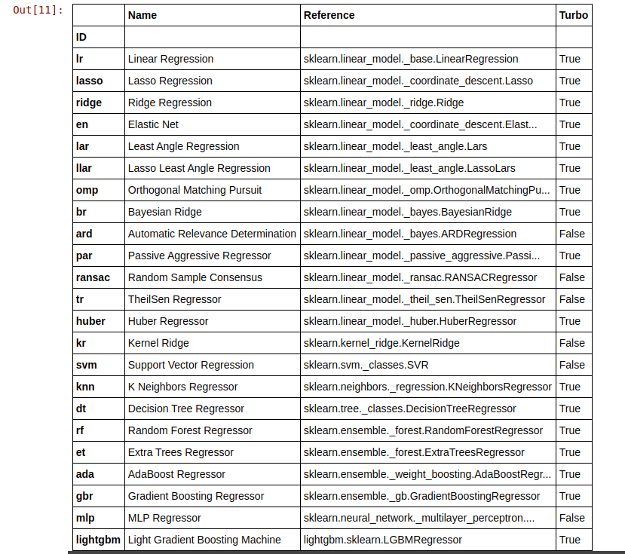
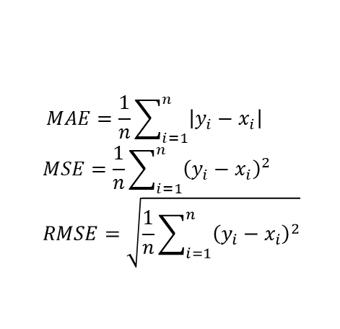
Running the ML algorithms
We apply a supervised learning approach, splitting the raw inputs into a train-test set (70%-30% split). The “train” set is used to build the model, and the “test” set is used to test that the model works. We “validate” the model using a totally new, never-before-seen data set.
A total of 20 models were tested as a first pass* using 10-fold cross validation; these models were ranked using the mean absolute error (MAE), the mean squared error (MSE) and the root mean squared error (RMSE).
Against outliers, the MSE and RMSE perform better
$$MAE=\frac{1}{n}\sum_{i=1}^{n}{\left|y_{i}−x_{i}\right|}$$
$$MSE=\frac{1}{n}\sum_{i=1}^{n}{{\left(y_{i}−x_{i}\right)}^{2}}$$
$$RMSE=\sqrt{\frac{1}{n}\sum_{i=1}^{n}{{\left(y_{i}−x_{i}\right)}^{2}}}$$
Where y_{i} is the prediction, x_{i} is the true value and n is the total number of data points.
The best 3 approaches are the Category Boosting (CatBoost), the Random Forest (RFR) and the Gradient Boosting Regressor (GBR).
Regressor Model | MAE | MSE | RMSE
Category Boost | 8.87 | 125.04 | 11.15
Random Forest | 9.39 | 135.10 | 11.61
Gradient Boosting | 9.66 | 141.37 | 11.87
Notes:
https://dacon.io/codeshare/2430

Slide 14
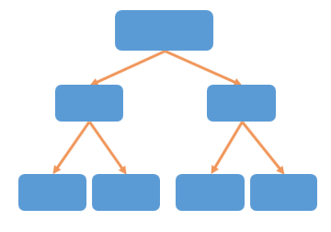
Differences in Algorithms
Fundamentally, all 3 algorithms are linked to decision trees
Decision trees can overfit, which is why it is necessary to either stop at a certain level or stop once the nodes reach a certain size (“Stopping criteria”). Alternatively, one can delete nodes (“Pruning”).
The best method however is known as an “ensemble average” i.e., data set is split into numerous small sets (bootstrapping), a decision tree is created for each, giving N learned models (X_{L}), which can than be combined to give an improved model that is robust to overfitting and outliers.
CatBoost: Able to handle categorical as well as numeric data. Does this without requiring the conversion of categorical to dummy variables
RFR: Insensitive to outliers, works on large number of variables, hard to overfit, requires a lot of CPU memory.
Data Size D
Level = 3
Node = 2
Root
X<x
X>=x
Left Node
Right Node
Y<y
Y>=y
Z<z
Z>=z
Left Node
Right Node
Left Node
Right Node
Y_{hat}
Y_{hat}
Y_{hat}
Y_{hat}
ensembling increases the performance of the models (in most cases) we can ensemble our model using bagging, boosting, blending, and stacking in PyCaret
1
2
3
4
X_{L}
3
6
5
4
X_{L}
N
times
2
1
3
6
X_{L}
d< D
X_{L}-Sample generated from bootstrap

Slide 15
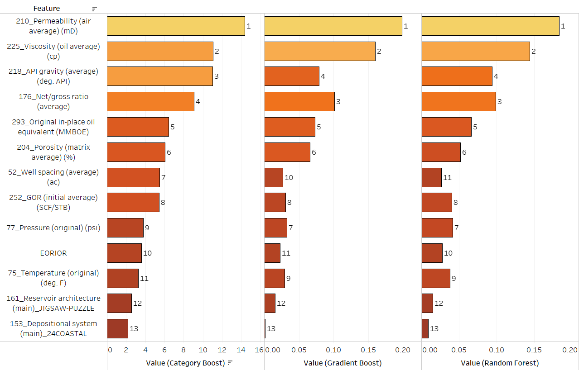

Top 13 Ranked Features for each Decision Tree Model
Rank out of sequence
Some interesting observations for the ranking of the top 13 features:
Permeability, viscosity, API, NTG, OOIP and Porosity appear to be the the 6 most important variables.
The remaining variables change in importance ranking depending on the algorithm employed
Categorical data is more important for the CatBoost algorithm than it is for the more “numerically weighted decision tree”.

Slide 16
Bias and Variance
As each model considers each feature differently, choosing an optimal model becomes challenging.
However, the end goal is to give an outcome of low bias and variance
Optimal Outcome:
Low Variance
High Variance
Underfitting
High Bias
Truth
Low Bias
Overfitting
Notes:
Bias is the difference between the average prediction of our model and the correct value which we are trying to predict. Model with high bias pays very little attention to the training data and oversimplifies the model. It always leads to high error on training and test data.
Variance is the variability of model prediction for a given data point or a value which tells us spread of our data. Model with high variance pays a lot of attention to training data and does not generalize on the data which it hasn’t seen before. As a result, such models perform very well on training data but has high error rates on test data.

Slide 17
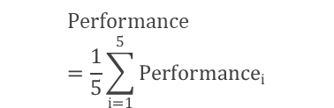
Cross Validation
The stability of the model can be validated using cross-validation.
Since our ML algorithm uses a single input data set, it is difficult to ascertain if it has picked up all the idiosyncrasies in the data – noise, patterns, outliers etc
K-fold Cross-validation allows you to create numerous small data sets by:
Dividing your data set into k subsets
Using (k-1) subsets to train the model, holding one out as a validation set
Validation Fold
Training Fold
1st
Performance₁
2nd
Performance₂
We have tested 5, 10 and 15 folds, and found that RFR performs better at 5 K-folds while the other models perform better at 10 K-fold
K Iterations (K-Folds)
$$Performance=\frac{1}{5}\sum_{i=1}^{5}{{Performance}_{i}}$$
3rd
Performance₃
4th
Performance₄
5th
Performance₅

Slide 18
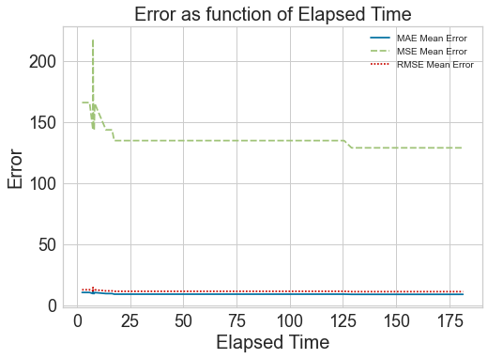
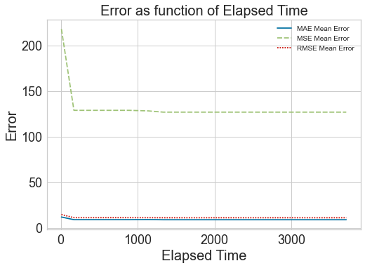
Tuning the Model by varying Hyperparameter
All ML algorithms have parameters that can be modified
These “hyperparameters” can be optimized via a random grid search to regression error (MSE and RMSE) metrics.
Optimization does plateau; more runs or more cross-validation will not reduce the error further.
For 10-fold cross-validation i.e. 10 subsets of the full training data, running it 50x means the optimization algorithm tunes the hyperparameters 50 times per model (using gradient descent). The total run time is 180s, and the MAE obtained was 9.12. Repeating this for 1,000 fits results in a run time of >1 hour , but the MAE only reduces to 9.07. Therefore, more iterations does not substantially minimize the error.
Local Minimum
Global Minimum
The solution converges rapidly at ~50 iterations in the hyperparameter grid search; adding more iterations to improve model performance is counter-productive since it only increases the training time
Notes:
hyperparameter is a characteristic of a model that is external to the model and whose value cannot be estimated from data. The value of the hyperparameter has to be set before the learning process begins.
parameter is an internal characteristic of the model and its value can be estimated from data.
Grid search builds a model for every combination of hyperparameters specified and evaluates each model.
In an optimization problem, minimize a function, but we don't know the values of the parameter that minimize that function. Then we use the gradient as information in the direction which to move the parameters, but it doesn't tell us how much to move, so we move a fixed amount (the step size or learning rate). Then considering all of this, if we do one step of moving into the gradient direction, we are closer to the solution (the minimum), but we just moved a little, then we move a little more, and so on. These are iterations. When you increase the number of iterations, you get closer to the minima and the set of optimal parameters, and these are what improve performance.
You are right that the same algorithm is being run, but not with the same inputs. The inputs keep changing, as the current value of the parameters changes after one iterations

Slide 19

Combining various ML techniques
Improving the predictive capability of ML an be done by “averaging” different interpreted models (Ensemble Modelling).
Bootstrap Aggregating (Bagging) – take (homogeneous) “weak learners” of the same type (same variables each time, but random subset), pass a prediction through each of them and and average the result. Each “weak learner” is independent
Boosting – “Strong learner” = Weighted sum of (homogeneous) “Weak Learners” with higher importance given to models that were difficult to predict in the previous step.
Blending/ Stacking – combining different “weak learners” – i.e. multiple models are trained to predict the outcome and a meta-model is created that uses the predictions from those models as an input along with the original features.
Single
Bagging
Boosting
Stacking
X
Classifier
X: Training Data
Y: Output Data
Y
1 Iteration
X
Classifier
Y
Classifier
Y
…
…
X
Classifier
Y
Parallel
Sequential
Level 0
Level 1
Notes:
https://www.mygreatlearning.com/blog/ensemble-learning/
Bagging is different from random forest (RF) as RF will not only take random subset, but also random variables p to train DT

Slide 20
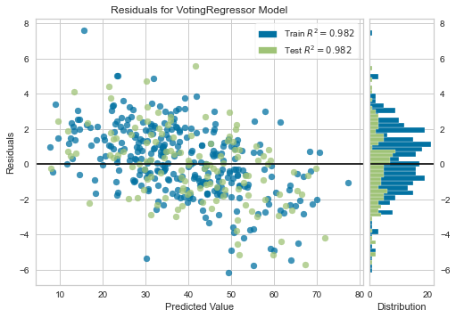
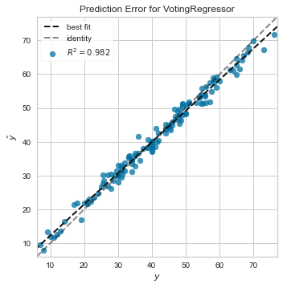
Final Solution
The optimal solution is a blend of all the tuned methods.
Regressor Model | MAE | MSE | RMSE
Pre- Hyper Parameter Tuning
CatBoost | 8.87 | 125.04 | 11.15
RFR | 9.39 | 135.10 | 11.61
GBR | 9.66 | 141.37 | 11.87
Post- Hyper Parameter Tuning
Blend (CatBoost+RFR+GBR) | 8.71 | 121.4 | 10.99
Boosted CatBoost | 8.89 | 122.75 | 11.06
Boosted RFR | 9.10 | 124.59 | 11.15
Boosted GBR | 9.03 | 125.63 | 11.19
Parameters Tuned |  | Optimised Solution
Error Minimization | MAE, MSE, RMSE | RMSE
Iterations | 0-1000 | 50
Averaging | Bagging/ Boosting | Boosting
Search Algorithm | Bayesian, Optuna, Hyperopt | Bayesian
Blending? | True/ False | True
Stack | True/ False | False
K-folds | 5, 10, 15 | 10

Slide 21
Machine Learning Approach
Data Collection
Data Preparation
Choose Learning Algorithm
Train the Model
Test the Model
Deployment/ Evaluation on a “Blind” Data Set

Slide 22






Deployment – Testing on a Blind Data Set
We have selected 4 fields from all over the world.
Latin America
Campos
Offshore
30 deg. API
23%
Former Soviet Union
Siberian Western
Onshore
~3756 psi
8544 ft TVDss
Latin America
Campos
Offshore
~200 deg.F
76 mD
Asia-pacific
Sarawak
Coastal
2500 Scf/Stb
0.39 cp

Slide 23
Conclusion

